Slide 1

DEPARTMENT OF ELECTRONICS AND COMMUNICATION ENGINEERING
INTERNSHIP SEMINAR
On
“Embedded system and IOT”
Carried out at
Electronics& Communication Engineering Department
GM Institute of Technology, Davangere.
During
11-10-2022 TO 30-10-2022
Presented by:
MURALIDHARA LS
4GM21EC059
Guide:
Mr. Sampath Kumar B
Assistant Professor

Slide 2


Introduction to Embedded system and Iot
Embedded system is computer system that is integrated into a devices (like mobiles, laptops etc) or products (like washing machine, refrigerator etc) to perform specific task.
The Internet of Things (IoT) is a network of connected devices that can communicate with each other like Alexa and Google assistant
Fig : 1.1 Embedded system
Fig : 1.2 IoT

Slide 3


About the software / tool used in internship
Arduino IDE:
The Arduino IDE is an open source software platform used for programming and developing projects with Arduino boards.
Tinkercad:
Tinkercad is a software developed by Autodesk. It is designed for beginners who are interested in creating 3D models for various purposes, such as 3D printing ,electronics, and robotics.
Fig : 2.1 Arduino IDE
Fig : 2.2 Tinkercad

Slide 4

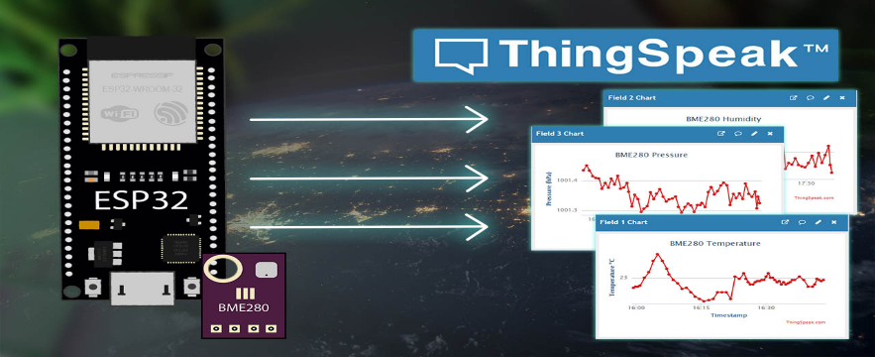
About the software / tool used in internship
Blynk App:
Blynk is popular IoT platform that provides a mobile app and cloud infrastructure to build and control IoT projects.
Thingspeak
Thingspeak is an Internet of Things platform that allows you to collect ,analyze, and visualize sensor data from connected devices.
Fig : 2.3 Blynk App
Fig : 2.4 Thinkspeak

Slide 5
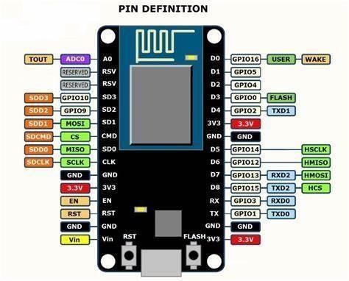
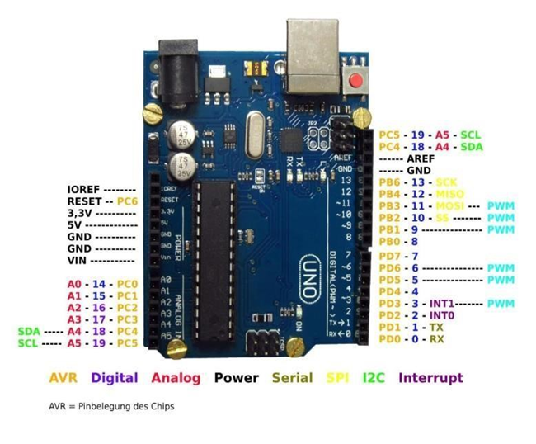
Concepts learnt during internship
Introduction To Embedded System And IoT.
Arduino ide installation.
Introduction to node MCU.
Introduction to Arduino uno.
Tinker cad.
Interfacing with node MCU.
IoT Analytics-Thinkspeak Internet Of Things.
IoT analytics-blynk IoT.
Fig : 3.1 Node MCU
Fig : 3.2 Arduino uno

Slide 6
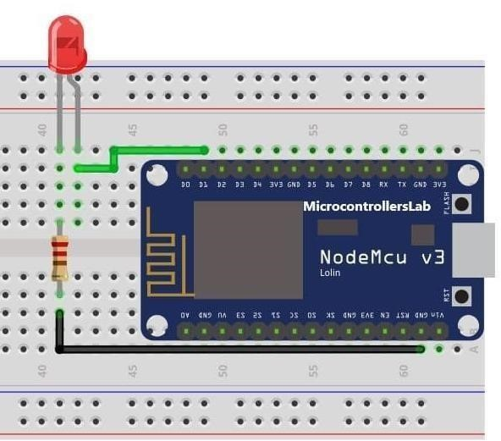
Interfacing with NodeMCU
1 . Interfacing Blinking LED with NodeMCU
Applications
Traffic lights
Vehicles indicaters
SL.NO. | COMPONENTS | QUANTITY
1 | ESP8266NodeMCU board | 1
2 | LED | 1
3 | 220-ohm resistor | 1
4 | Breadboard | 1
5 | Jumper wires | -
Fig : 3.3 Blinking LED
LED | NODE MCU
Positive Pin | D 13 Pin
Negative Pin | GND Pin

Slide 7
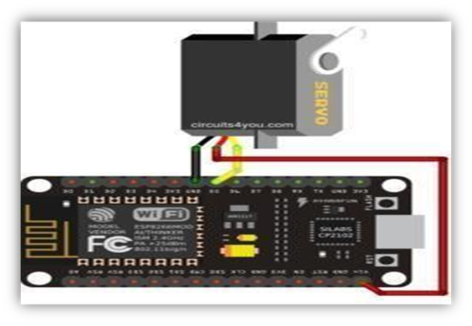
2. Interfacing Servo Motor with NodeMCU
Applications
Textile Machine
Robots
Fig : 3.5 Servo Motor
SL.NO | COMPONENTES | QUANTITY
1 | ESP8266NodeMCU board | 1
2 | Servo motor | 1
3 | Breadboard | 1
4 | Jumper wires | -
SERVO MOTOR | NODE MCU
VCC Pin | Vin Pin
GND Pin | GND Pin
Signal pin | D3 Pin

Slide 8
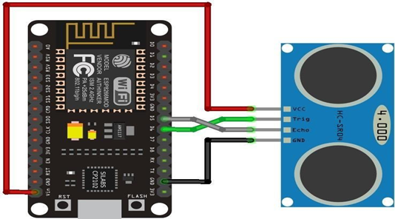
3. Interfacing Ultrasonic sensor with NodeMCU
Applications
Anti-Collision Detection.
People Detection.
Fig : 3.9 ULTRASONIC SENSOR
SL.NO. | COMPONENTES | QUANTITY
1 | ESP8266NodeMCU board | 1
2 | Ultrasonic Sensor | 1
3 | Breadboard | 1
4 | Jumper wires | -
ULTRASONIC SENSOR | NODE MCU
VCC Pin | 5V Pin
TRIG Pin | D2 Pin
ECHO Pin | D1 Pin
GND Pin | GND Pin

Slide 9
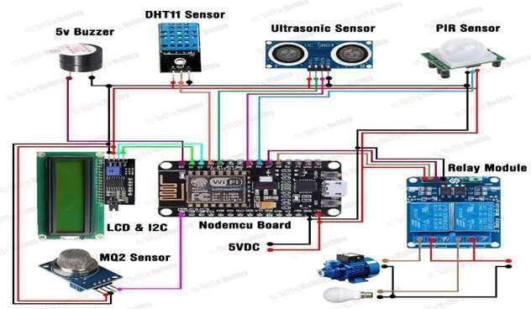
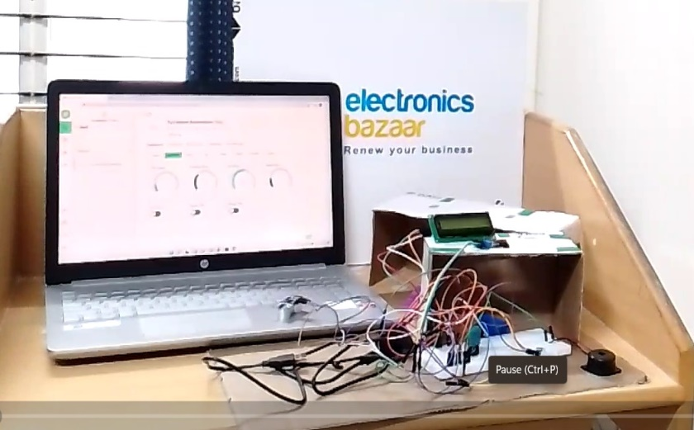
Project learnt during internship
SMARTHOME AUTOMATION SYSTEM:
Component required:
NodeMCU board
LCD display
Ultrasonic sensor
PIR sensor
MQ-2 sensor
DHT11 sensor
Buzzer
Jumper wires
Power source

Slide 10
Outcome of the internship
I gained a deep understanding of the fundamentals of Embedded System and IoT.
I also got hands-on experience in designing and implementing smallscale IoT systems using different platforms such as Arduino.
The project assignments provided me with opportunities to practice problem-solving skills, learn new programming languages and development tools.
Learn to work with different sensors and actuators.

Slide 11
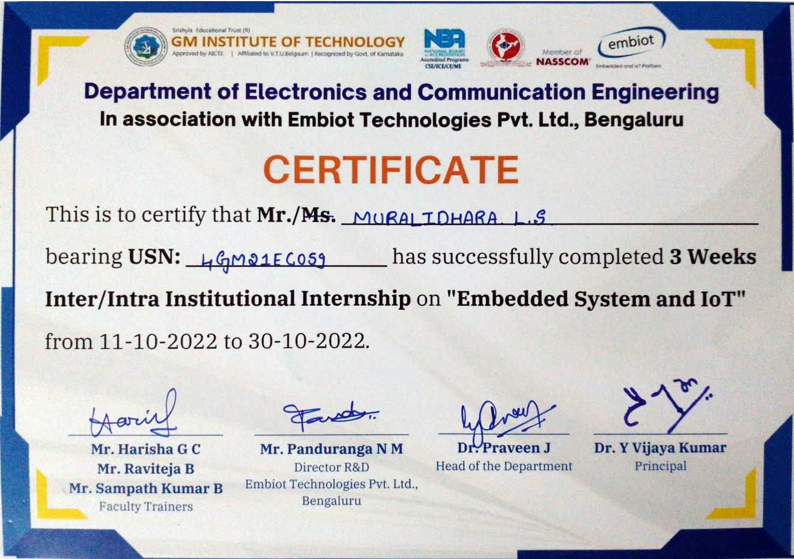

Slide 12
References
Internet of things by Srinivasa K.G / Hanumantha Raju R. [Text book]
https://youtu.be/PSo3m7euzo0 [You Tube class]
https://www.tutorialspoint.com/the-role-of-embedded-systems-in-the-internet-of-things-iot [Website]
https://www.tinkercad.com/dashboard [Tinkercad software]

